Slide 1
Lecture 3
Introduction to Bangladesh: History of Ancient

Slide 2
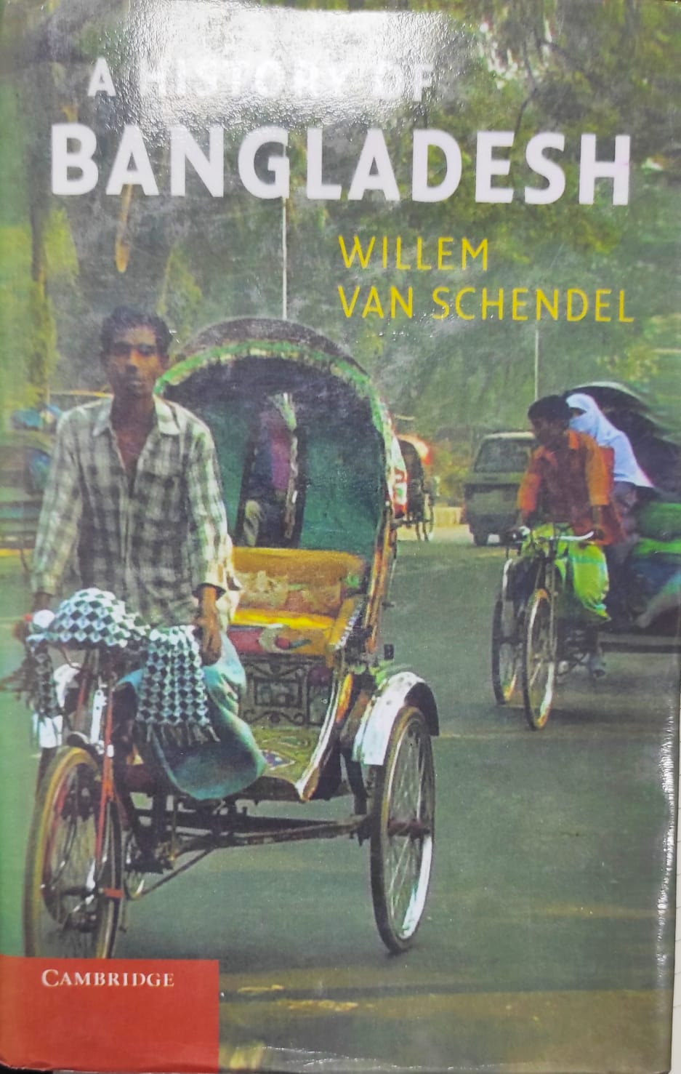
A History of Bangladesh

Slide 3
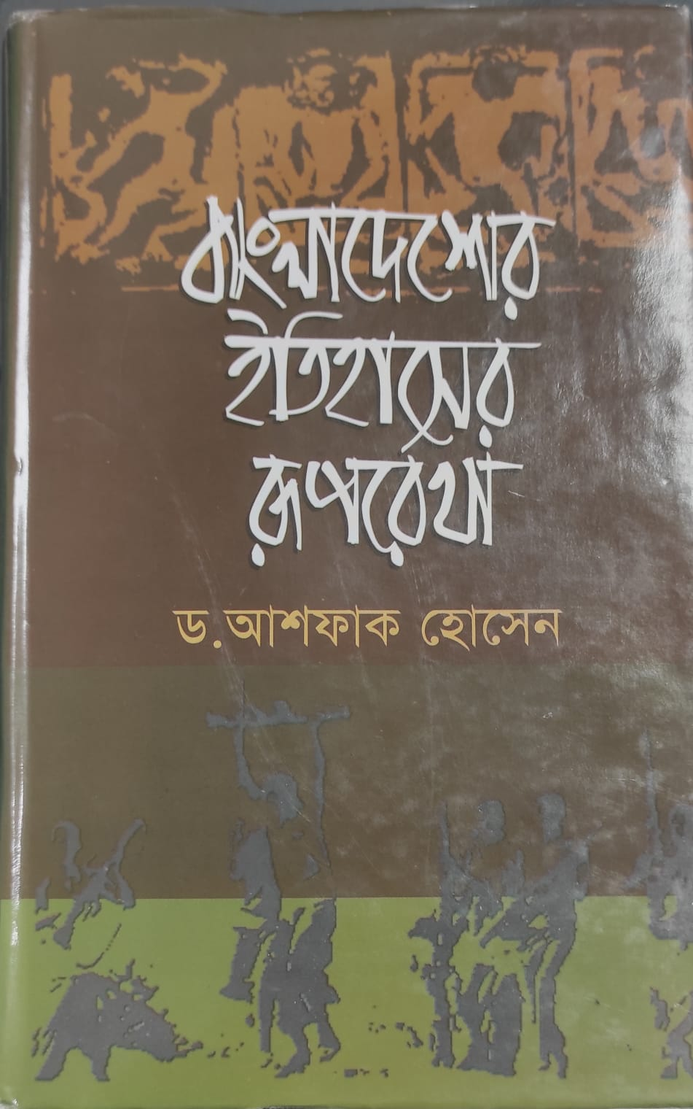

Slide 4
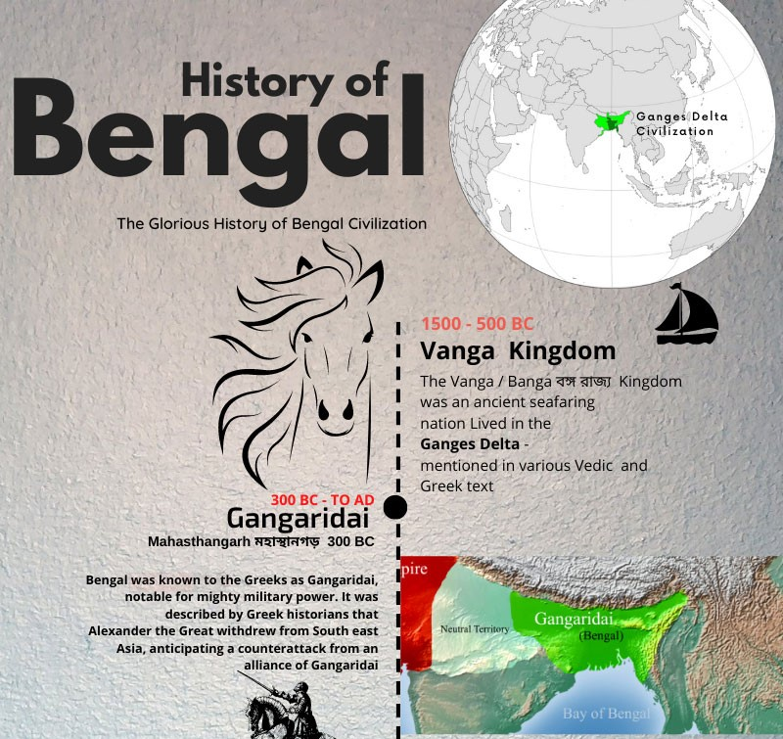

Slide 5
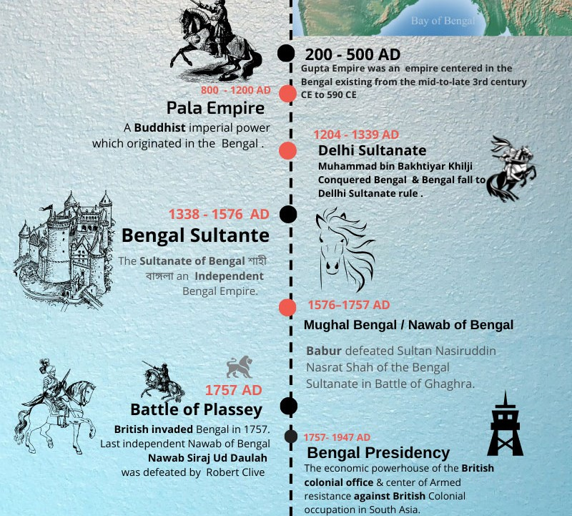

Slide 6
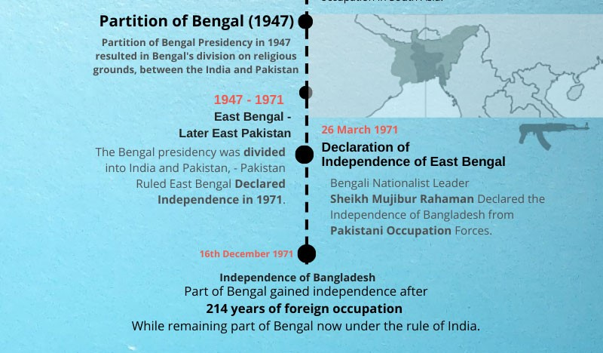

Slide 7
gupta
Gupta Rule forms an important chapter in the history of ancient Bengal. Gupta rule spread over Bengal probably in the reign of Chandragupta I or Samudragupta towards the end of the 3rd or the beginning of the 4th century AD. Eulogical inscriptions (prashasti lipi), copperplate coins, literary evidences, and foreign accounts bear testimony to the existence of Gupta rule in Bengal.

Slide 8
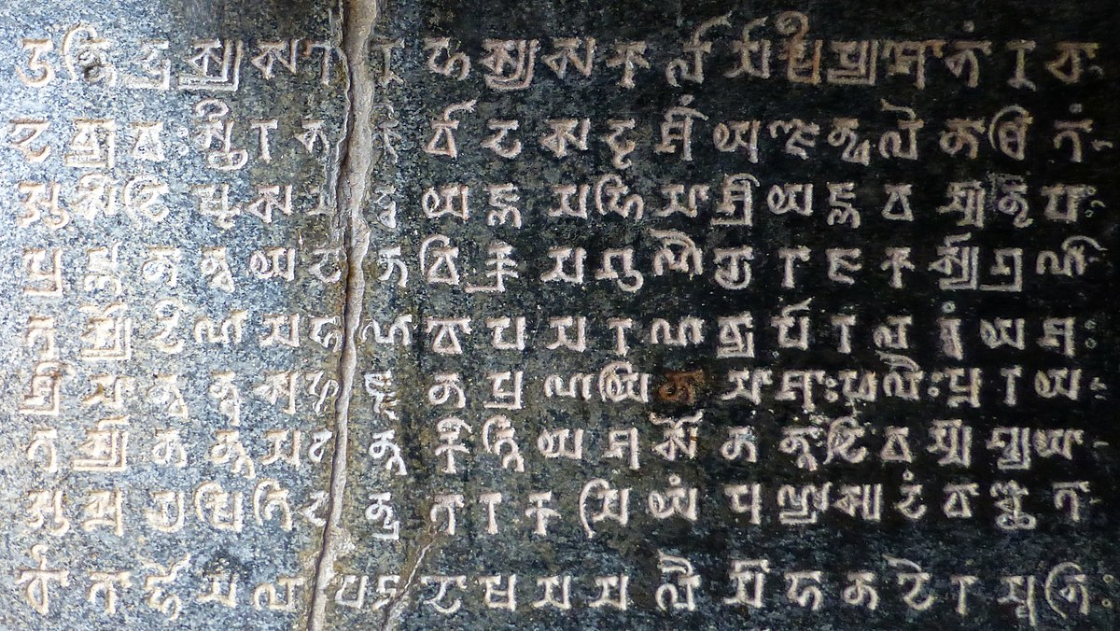
prashasti lipi

Slide 9
https://www.youtube.com/watch?v=57a2M1Fw99g
https://www.youtube.com/watch?v=ZoHKHm3_mYs
https://www.youtube.com/watch?v=eH6JRD844vg

Slide 10
https://www.youtube.com/watch?v=KrVUUfWz_g0 https://www.youtube.com/watch?v=xwGtcsQLzWw https://www.youtube.com/watch?v=AusE2iBcgug BBC https://www.youtube.com/watch?v=71tGcl52zVw https://www.youtube.com/watch?v=RgYwOq0rmEo

Slide 11
Gupta
In the Gupta period, Bengal was divided into some well-defined administrative units like
bhukti,
visaya,
mandala,
vithi, and
grama.
Each of the units seems to have an adhikarana or office of its own at its headquarters (adhisthana). The title of the administrator of visaya was Kumaramatya and Ayuktaka. From the inscriptions, we know the names of such visayas like Kotivarsa visaya, Panchanagari visaya, Barakmandala visaya etc. There was a kind of officials, named pustapala (record keeper), in the adhikarana of the visaya.

Slide 12
gupta
Economically, Gupta rule brought stability, facilitating trade and commerce. This prosperity supported advancements in art, literature, and science, with Bengal contributing to the broader cultural efflorescence of the Gupta era. The architecture and sculpture from this period often depicted Hindu deities and epic narratives, signifying the religious and artistic vibrancy that extended into Bengal.

Slide 13
sen
Sen Dynasty ruled Bengal for little over a century (c 1097-1225). The emergence of the dynasty, who supplanted the Palas in Bengal towards the close of the 11th century AD, is a very important chapter in the history of ancient Bengal. Taking advantage of the revolt of the Samantachakra in the Varendra during the reign of Mahipala II, Vijaysena, the founder of the Sena dynasty, gradually consolidated his position in Western Bengal and ultimately assumed an independent position during the reign of Madanapala. One important aspect of Sena rule in Bengal is that the whole of Bengal was brought under a single rule for the first time in its history.

Slide 14
sen
The rule of the Sens in Bengal is usually connected with the emergence of orthodox Hinduism in a Hindu-Buddhist society which for long had enjoyed the peaceful coexistence of the two religions resulting in an atmosphere of amalgam of the two. The onslaught on the Buddhists in Bengal is believed to have started in this period, which resulted in large scale Buddhist migration to the neighbouring countries.

Slide 15
sen
During this period, the Sena rulers promoted Brahmanical traditions, leading to a revival of Hindu culture and religious practices. They patronized scholars, poets, and religious institutions, contributing to the cultural and intellectual life of Bengal. Ballala Sena, for instance, is credited with codifying social customs and practices through works like Danasaagara and initiating the kulin system to organize Brahmin society.

Slide 16
sen
Lakshmana Sena, the last significant ruler, was known for his patronage of literature and arts, supporting prominent poets such as Jayadeva, who composed the Gita Govinda. The Sena period also witnessed advancements in temple architecture, with a focus on Hindu deities and intricate carvings.
However, the dynasty faced challenges towards the end, culminating in its decline with the invasion of Bakhtiyar Khalji, a general of the Delhi Sultanate, in the late 12th century. This conquest marked the end of Sena rule and the beginning of Muslim influence in Bengal.

Slide 17
Medieval Bengal
Bengal came under the control of the Delhi Sultanate after Bakhtiyar Khalji’s conquest, marking the beginning of Islamic influence in the region. This period was marked by frequent shifts in power as various governors and regional leaders declared independence from Delhi, leading to the establishment of the Bengal Sultanate in 1352 under Shamsuddin Ilyas Shah. The Ilyas Shahi and later Husain Shahi dynasties brought relative stability and prosperity. The Husain Shahi period, in particular, is remembered as a golden age for Bengal, with advances in trade, culture, and architecture.

Slide 18
Medieval Bengal
Bengal came under the Mughal Empire after the conquest by Emperor Akbar in the late 16th century. The region became a prosperous and integral part of the Mughal Empire, known for its agricultural productivity, trade, and manufacturing, particularly of textiles such as muslin. The Mughals maintained control through powerful subahs (governorships) with Dhaka serving as an important administrative and economic center.

Slide 19
Medieval Bengal
The making of Suba Bangla, as an administrative unit under the Mughal imperial system began with Akbars partial conquest of Bengal and achieved its maturity at the close of the eighteenth century. During the time there were remarkable changes both in the political geography of the suba as well as in its internal administration and relationship with the centre.

Slide 20
Medieval Bengal
Akbar breathed his last before his authority was established in Bengal. Akbar's control was limited only in a small area comprising Ghoraghat in the north, Satgam, Burdwan in the south-west. the river Karatoya and Sherpur. Murcha in the east and Rajmahal in the west.

Slide 21
Medieval Bengal
Bengal was a major hub in the Indian Ocean commerce network during the Middle Ages because of its affluence, which drew traders and people from all over the world. It was known across the world for producing exquisite textiles, particularly muslin. Bengal witnessed the cultural blending of Islamic and Hindu traditions, which had an impact on literature, music, and religious rituals. The Sufi and Bhakti traditions gained traction by encouraging inclusion and spiritual devotion.

Slide 22
Medieval Bengal
Semi-independent nawabs emerged in Bengal as a result of the Mughal Empire's fall in the early 18th century. At the Battle of Plassey in 1757, the British East India Company defeated Siraj-ud-Daulah, the final independent Nawab of Bengal, marking the end of the era. With this incident, medieval rule came to an end and British colonial rule began.

Slide 23
References
Banglapedia - https://en.banglapedia.org/index.php?title=Main_Page
Sirajul Islam (ed.) (1997). History of Bangladesh, 1704-1971. [Asiatic Society of
Bangladesh, Dhaka]

